Slide 1
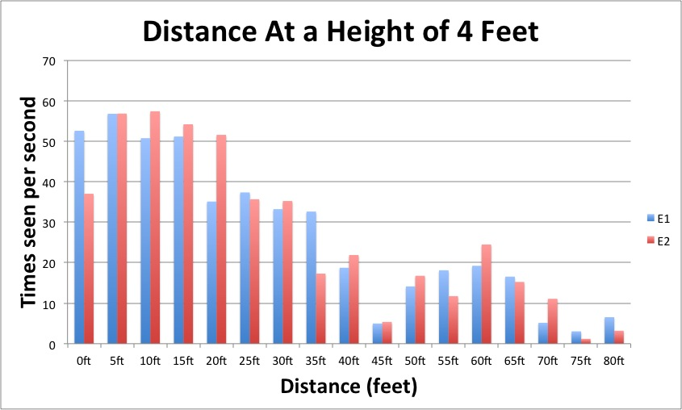
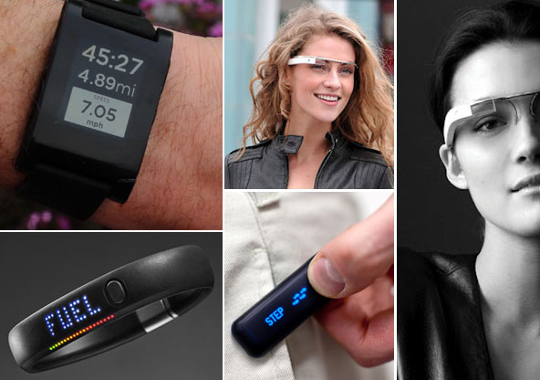
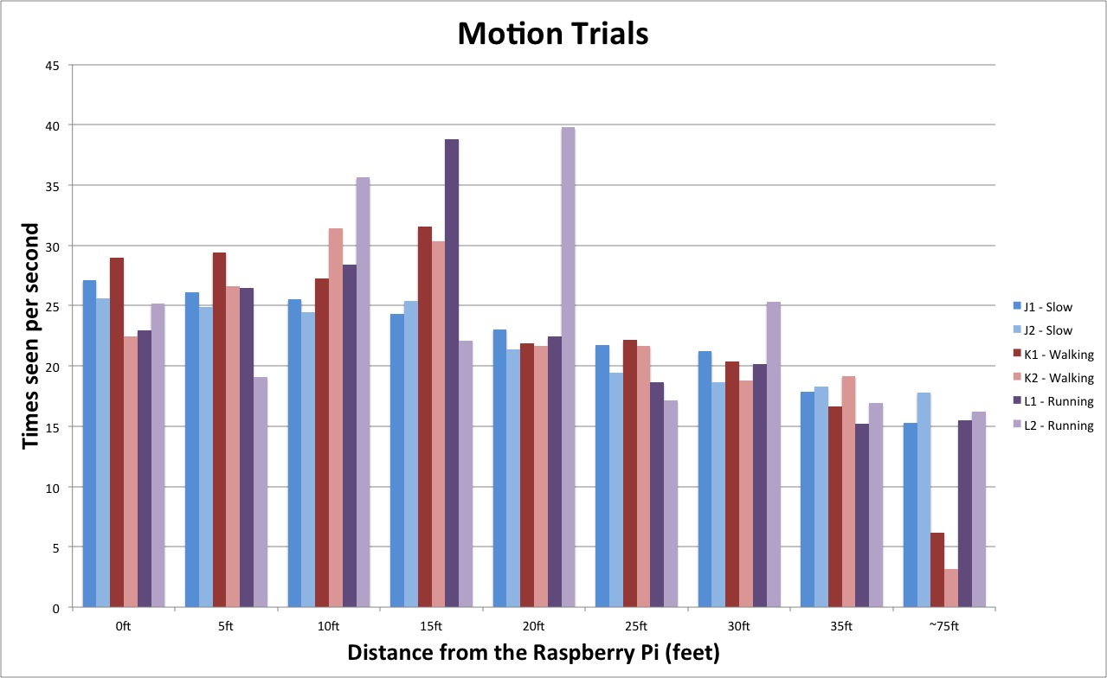
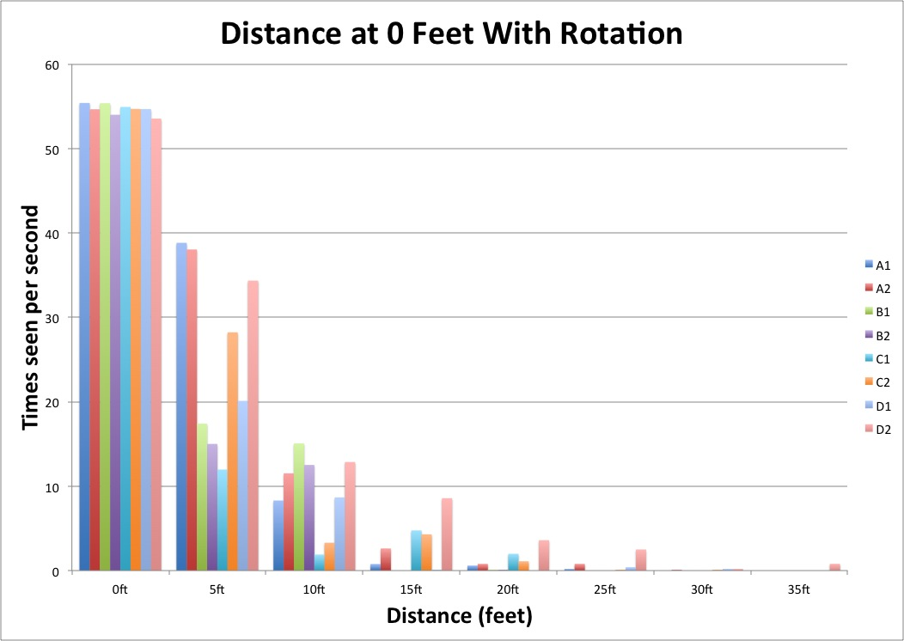
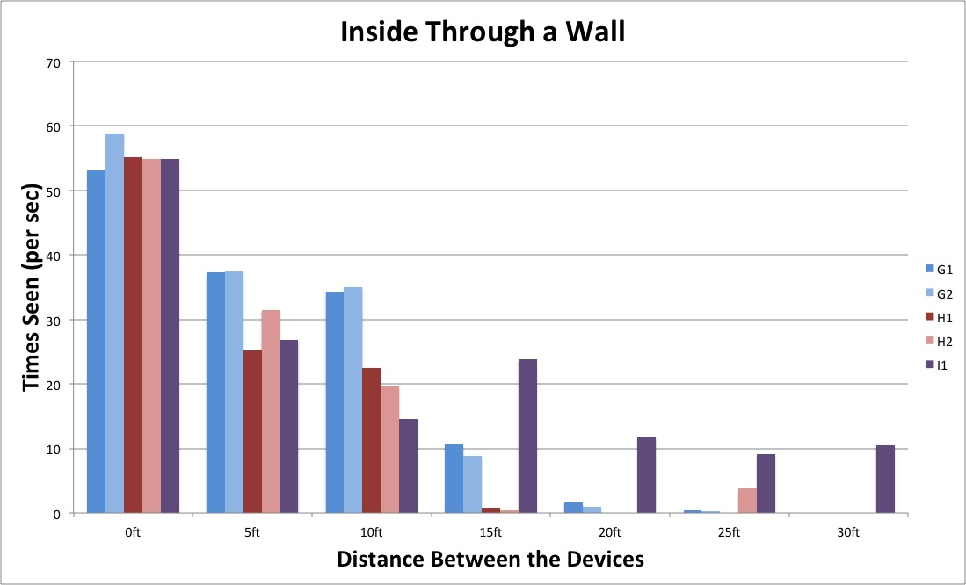
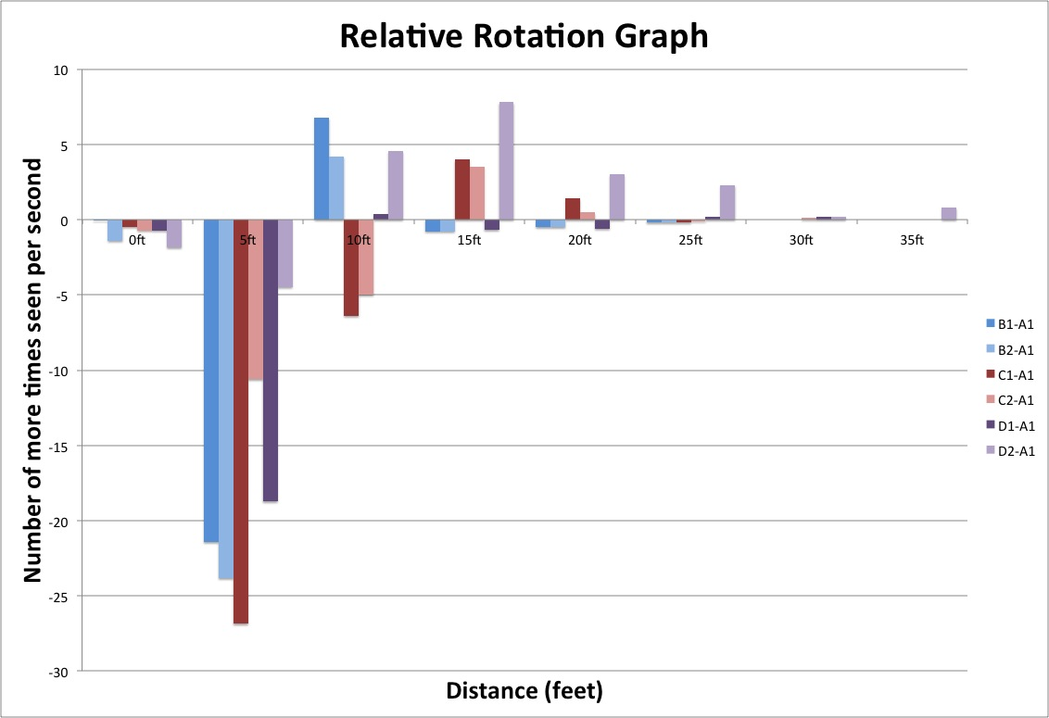
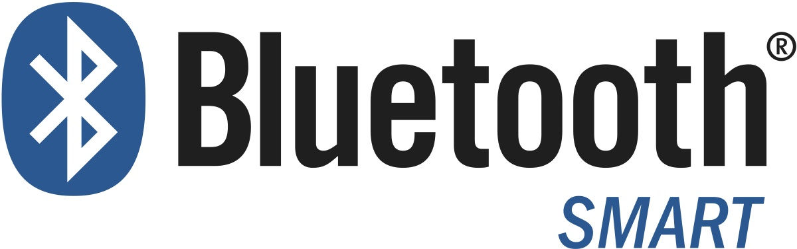
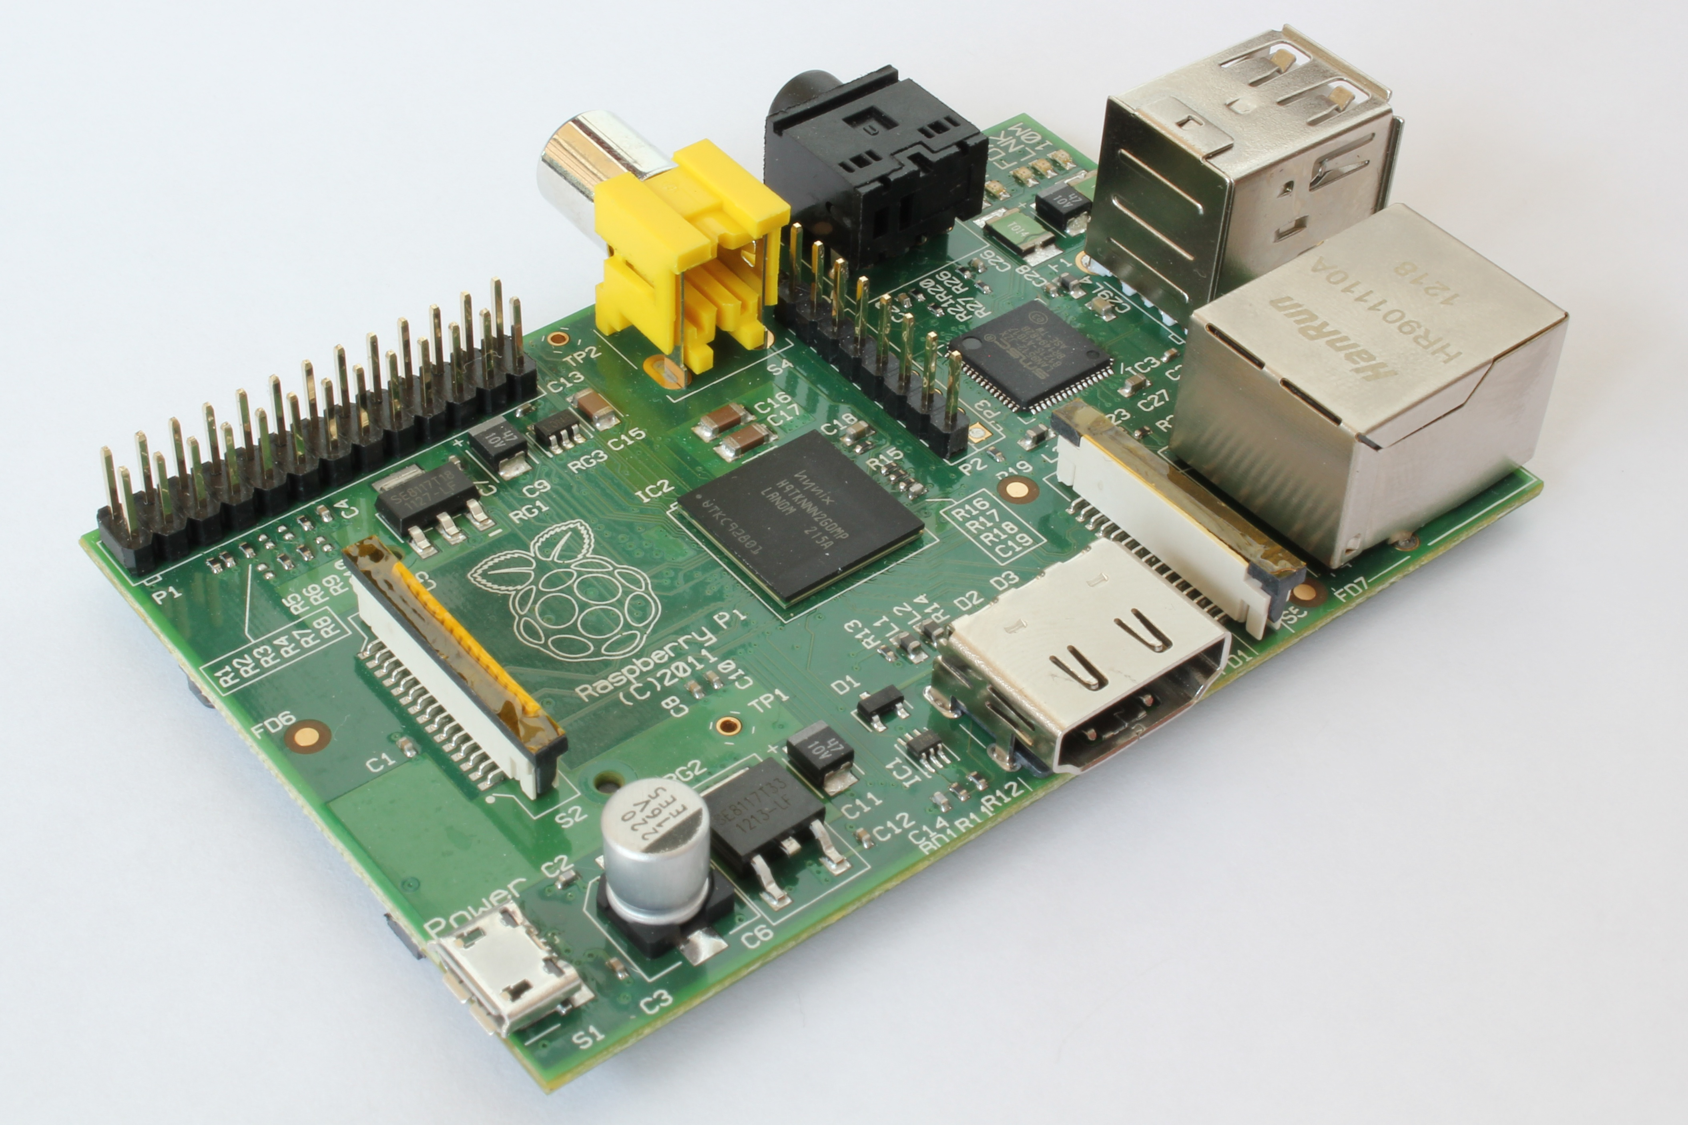
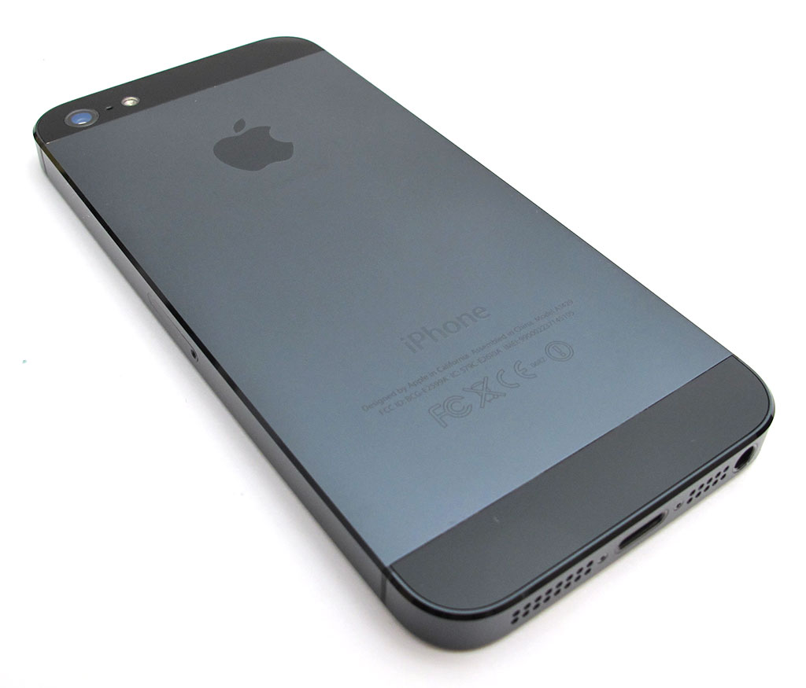
Determining the Practical Range of Bluetooth Low Energy on an iPhone and a Raspberry Pi
Introduction
Methodology
Results Cont.
Today’s world is booming with new technology from wearables to drones to technology-infused cars. This multitude of technological advances is becoming so ingrained into our daily lives that our world requires a way to wirelessly interconnect them. Bluetooth Low Energy may just be that system, but its practical range remains uncertain in many situations.
In all of the tests, we measured the number of times the Raspberry Pi saw a Bluetooth Low Energy beacon from an iPhone 5. The first step in determining the practical range was to establish a baseline and determine whether the direction of the Bluetooth nub mattered. These two were tested in ideal conditions. Then the Raspberry Pi was raised to a height of 4 feet, and the experiments were repeated using the ideal orintation of the nub. Placing the Raspberry Pi back on the ground, motion tests were performed by moving in a straight line with the closest point being the measurement. Lastly, the first test was repeated in practical conditions, with a wall between the devices. It was tested moving each device away from the wall as well as moving both devices.
When first determining the ideal orientation of the Bluetooth nub, it appeared as though 0º was ideal. Although 0o was the strongest, 180o turned out to be most consistent over the longest distance, making it the ideal orientation.
When comparing the height of 0 feet and 4 feet, it became very apparent that a height of 4 feet greatly increased the range. A distance of 80 feet was the farthest that the available setup could test.
With a wall placed between the two devices, very little difference was seen through 15 feet, but at distances greater than 15 feet, the signal was strongest by far when neither device was next to the wall.
Graph 3: Outdoor distance tests with the Raspberry Pi at a height of 4 feet.
Results
Graph 1:
Distance tests at a height of 0 feet, with rotation trials.
Trial A = 0º
Trial B = 90º
Trial C = 180º
Trial D = 270º
Purpose
Conclusions
With the beginnings of smart appliances around the home, technology such as Bluetooth Low Energy is becoming more important than ever, but little is known about its range. This experiment was designed to determine the practical range of Bluetooth Low Energy both inside and outside.
Graph 4: Outdoor motion trials with the Raspberry Pi on the ground and the iPhone 5 at waist height, at three different speeds.
The goal in this experiment was to determine the ideal setup for consistently detecting an iPhone using Bluetooth Low Energy and determine its range.
The ideal indoor setup consisted of:
placing the Raspberry Pi at a height of 4 feet
away from a wall
with the Bluetooth nub facing away from the general location of the iPhone
Its range exceeds 80 feet
*
*
Hypothesis
A Raspberry Pi using a Low Energy Bluetooth USB nub will be able to detect nearby devices from a distance no greater than 40 feet.
Graph 2:
Comparison of each rotation to the 0º trial. Positive values refer to a greater number of times seen.
Graph 5: Indoor trials with a wall between the iPhone 5 and the Raspberry Pi, moving the iPhone 5, Raspberry Pi, and both, respectively.

